Slide 1


Intermediate
Electronics and Lilypad
Where Electronics Meet Textiles
Workshop with
Lynne Bruning and
Troy Robert Nachtigall
Sponsored by
Spark Fun and PlugandWear
Versione 3.0 - January 2010

Slide 2
Analog

Slide 3
Analog Input

Slide 4

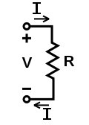

Resistance
3 the degree to which a substance or device opposes the passage of an electric current, causing energy dissipation.

Slide 5

What is Analog?
Analog electronic components work by varying the current of electricity
The Arduino has a built in Analog to Digital converter.
The ADC translates analog signal to a digital code.
This is very important to
textile sensors

Slide 6
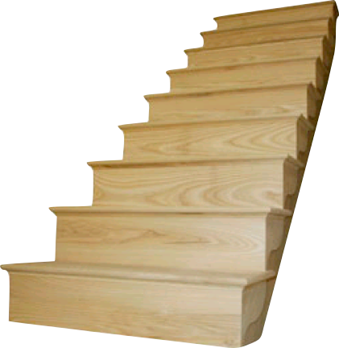
Arduino
Analog to Digital Convertor
10 bit ADC
= 2¹⁰
= 1024 levels
5V
/ 1024
= 0.0048V (4.8 mV)
5V = level 1023
4.9952 V = level 1022
0.0144 V = level 3
0.0096 V = level 2
0.0048 V = level 1
0V = level 0

Slide 7

analog input
Use the analogRead function to read from an analog sensor
We need load the value into a variable
variable = analogRead(PIN);
textileresistence = analogRead(buttonPin);
  be sure to declare your variables in setup
int texe;
texe = analogRead(10);

Slide 8
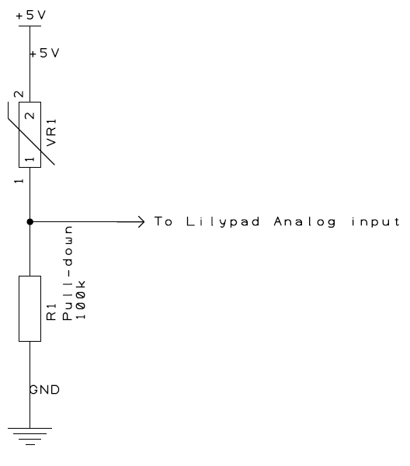
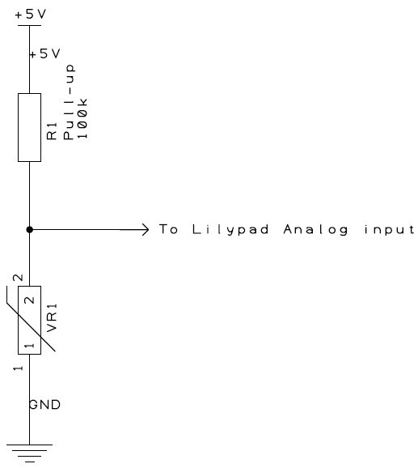
The trick to reading an analog input
Analog Read requires an extra resistor.
This resistor helps define 0V or 5V leaving no possibility for an empty reading.
Leaving this out can lead to misinformation

Slide 9
Analog Output
Sometimes on and off is just not enough.

Slide 10
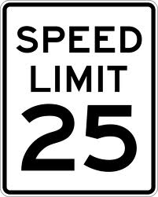
Digital to analog Converter (DaC)
One of the amazing things about Arduino is it’s ability to vary the output voltage on Pins 3,5,6,9,10,11
This allows us to dim LED’s or change the sound of a piezo (Music)
Acceptable output
signal levels
5V
HIGH
4.2V
0.9V
LOW
0V

Slide 11
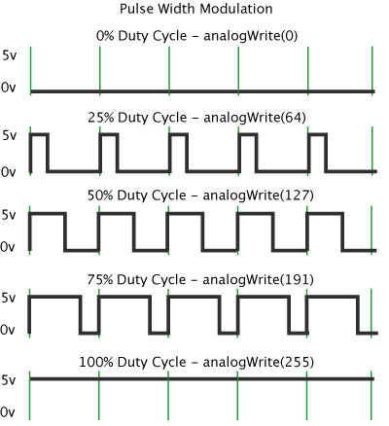
How it works
3,5,6,9,10,11
Only on PINS 3,5,6,9,10,11
Blinking faster than the eye can see.
It’s actually fake.

Slide 12
analog write
Use the analogWrite function to vary voltage on pins 3,5,6,9,10,11
Analog Write works on a
0 to 255 (8 bit) scale
analogWrite(PIN,VALUE);
Each value step is equal
to .02 volts
255
5V
127
2.5V
0
0V

Slide 13
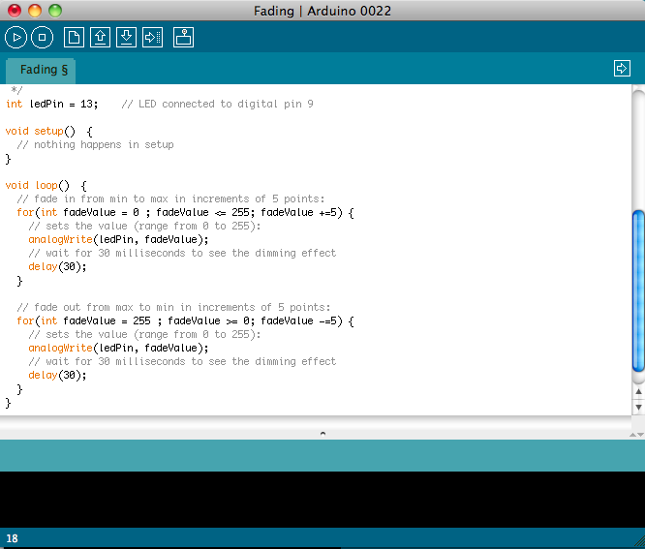
Let’s Try it
Load up the sketch
/Examples/Analog/Fading
Note how it fades.

Slide 14
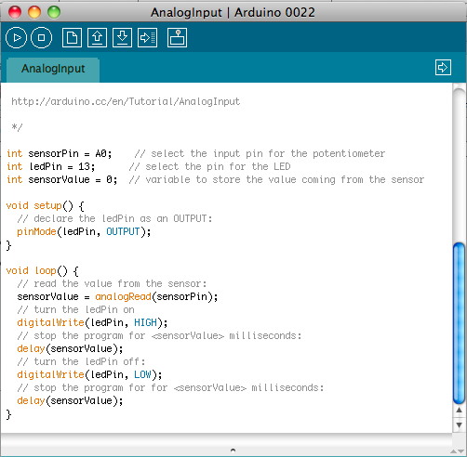
Let’s Try it
Load up the sketch
/Examples/Analog/AnalogInput
Connect the aligator clips to
- and a0
Search for conductive materials

Slide 15
So now we can read our sensors.
BUT what ARE THEY SAYING?

Slide 16
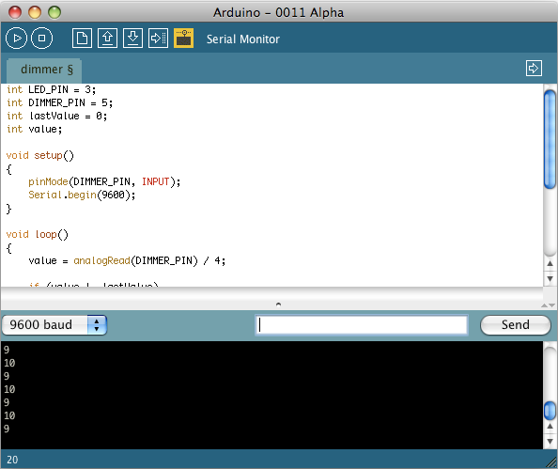
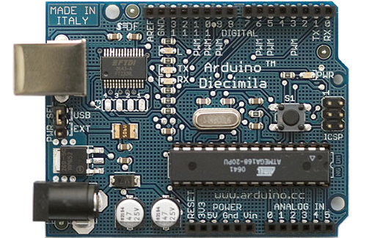
Serial Port
SERIAL COMMUNICATION

Slide 17
Serial Port
Serial requires PINs 1 & 0
The function Serial.begin() opens the serial port and sets it’s speed in setup.
The function Serial.print() writes a value to the serial port
The function Serial.println() writes a new line to the serial port
// initiate Serial Com and set speed
// SPEED
Serial.begin(9600);
// Print the VALUE to the serial port
Serial.print(VALUE);
// Print a newline to the serial port
Serial.println(“Soft Sensor”);

Slide 18

Mmmm… Serial
/* AnalogReadSerial Reads an analog input on pin 0, prints the result to the serial monitor This example code is in the public domain. */void setup() { Serial.begin(9600);}void loop() { int sensorValue = analogRead(A0); Serial.println(sensorValue, DEC);}
Serial output lets us understand what our sketch is doing.
Serial lets us use our arduino as a meter.
Load sketch Example/ Basics / AnalogReadSerial

